Slide 1
Welcome to your Resource Overview
Quick reference guide

Slide 3
Club President

Slide 5
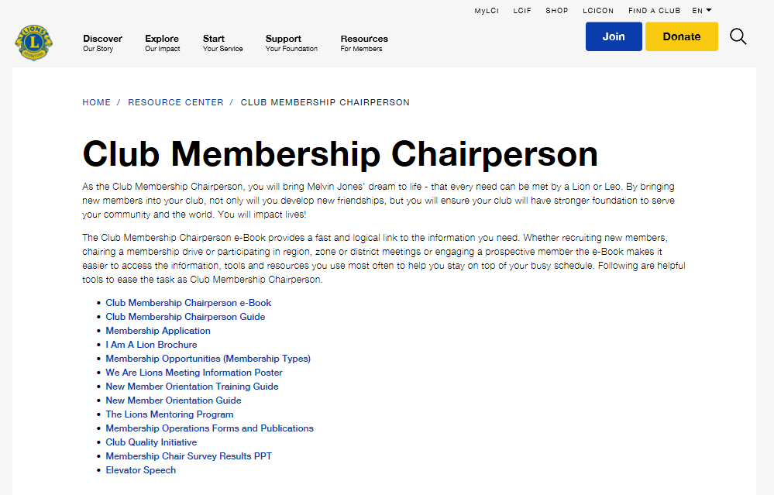

Slide 10
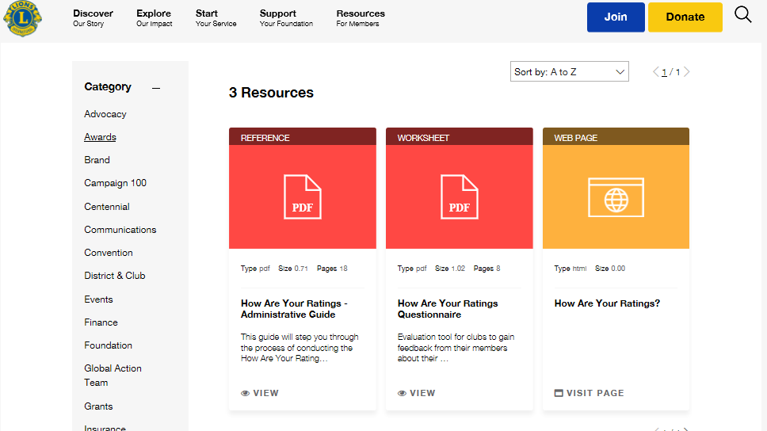

Slide 11
